Slide 1
Model Illinois Government

Slide 2
Model Illinois Government (MIG) is one of the preeminent intercollegiate government simulations in the United States, providing students with an in-depth look at the workings of state govenremnt and politics.

Slide 3
Averages
20 members schools
300+ students, faculty, and staff
Lasts Thursday night- Sunday morning
2022 Dates: March 3rd – 6th

Slide 4
Finances
What we really pay for…
Reserving the Capitol building/ Doormen
Reserving the Old State Capitol/ Overtime employees
Social events throughout the weekend
Closing ceremony with the hotel
Awards for students
Etc.
Our finances were harmed by having a virtual simulation due to COVID-19
Most students assume we just help pay for hotel rooms and our closing ceremony.

Slide 5
$15,000
The average cost of one simulation

Slide 6
Donations
To keep delegate and delegation prices low, we have recently created a donation page
($45/$300)

Slide 7
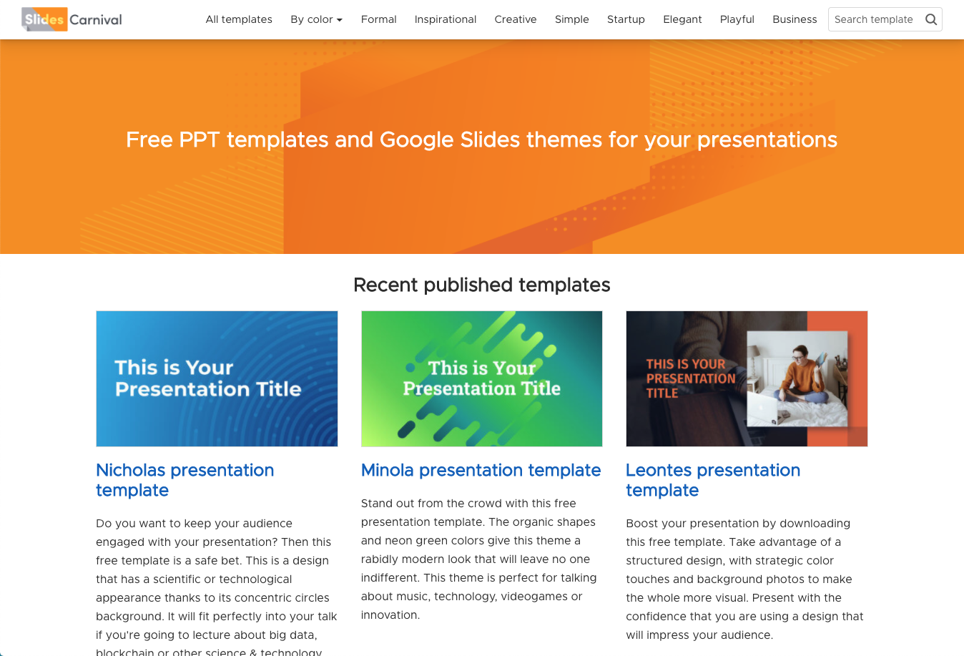
Donations can be made at
Modelilgov.org/support-mig

Slide 8
Tiered Donations
Governor’s Circle: $1,000+
Platinum MIG Alumni: $500+
Silver Sponsor: $300+
Bronze Benefactor: $200+
Delegate Donor: All other monetary donations

Slide 9
Advertisements- The MIG Journal
An alternative to a regular donation is to purchase an advertisement in the MIG Journal
The MIG Journal is the main source of information for all MIG members over the weekend
$25/ per day of advertisement
4 days available

Slide 10
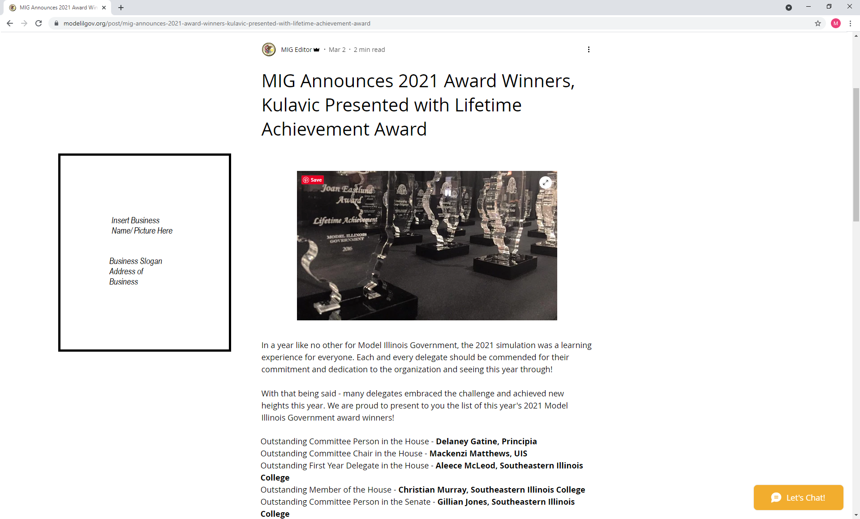
Advertisement Example

Slide 11
Thanks!
Any questions?
You can contact me at:
Attorneygeneral@modelilgov.org

